Slide 1
Prediction Markets

Slide 2
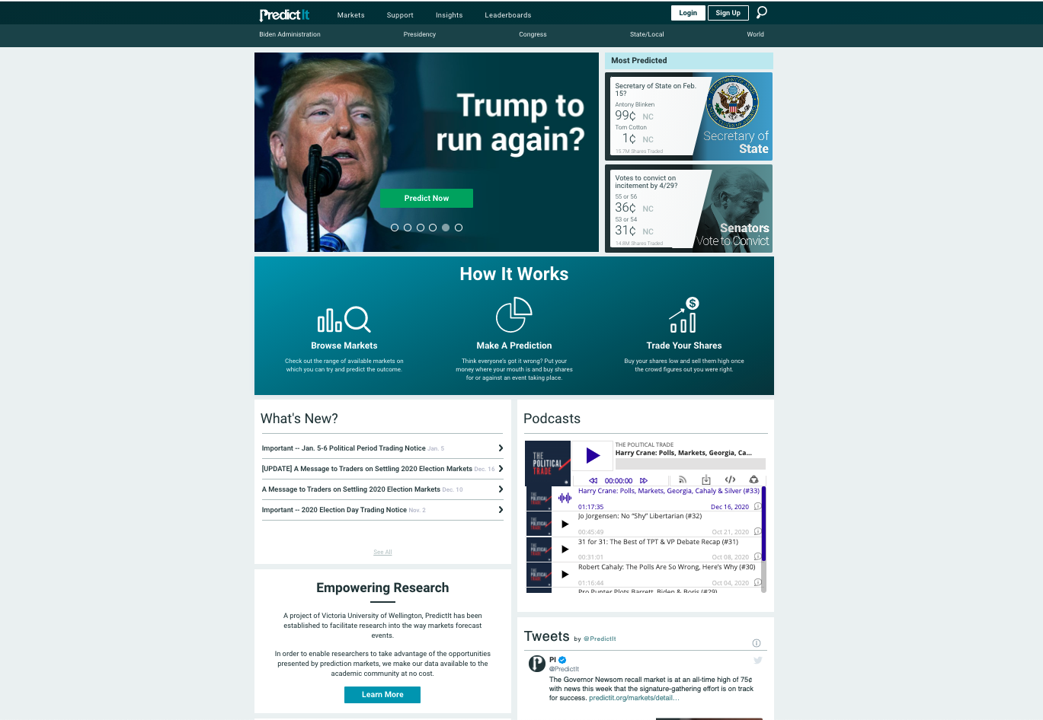
Notes:
Screenshot of predictit.org as of 7 February 2021, 9:34am EST
For sake of explanation, use example of “Will Donald Trump file to run for president before the end of 2021?”

Slide 3
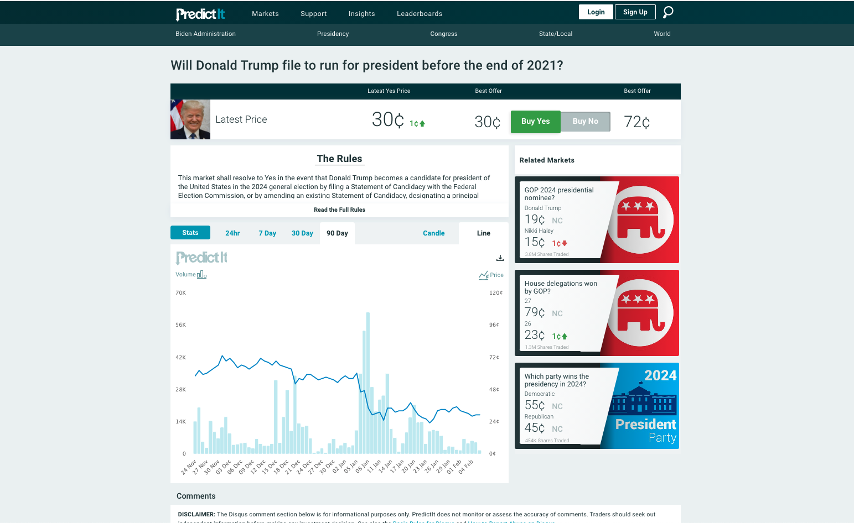
Notes:
2021 Jan 6: Storming of the US Capitol; Congress certifies election results for Joe Biden – closing price drops from 46 cents on Jan 6 to 29 cents on Jan 9 with significant spikes in volume
2021 Jan 13: House of Representatives adopts an article of impeachment against Donald Trump
2021 Jan 20: Inauguration of Joe Biden

Slide 4
Outline of lecture
Definitions: Terms related to (prediction) markets
Theory: Basic pricing models, prices as probabilities
Practice examples: Prediction markets working in the wild
Case study: Interesting findings from Google's PM

Slide 5
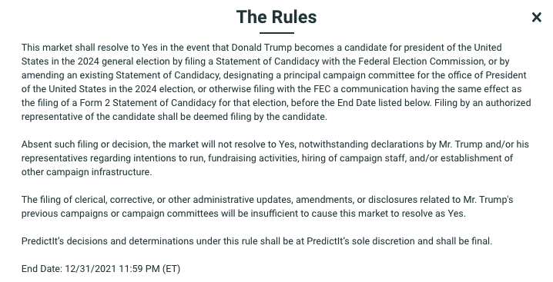
Definitions
AKA information market or event futures
Traders buy/sell contracts which have a payout tied to the unknown outcome of some future event
Outcomes of events must be unambiguous and verifiable by some predetermined time
Predictit.org’s formal rules for the prediction “Will Donald Trump file to run for president before the end of 2021?”
Notes:
Have to have a verifiable outcome. Cannot be something like "Will climate change be catastrophic?". Even obvious things can even be a bit ambiguous: Will Hillary Clinton win the election? Well, she won the popular vote, but not the presidency.
Screenshot: Screenshot of the rules of the example prediction “Will Donald Trump file to run for president before the end of 2021?”

Slide 6
Definitions
Bid/Ask: Buyers/sellers choose prices and trades occur only when they match
Market Makers: Individuals agree to make trades, profit from spread
Notes:
Bid price: the maximum price a buyer is willing to purchase at
Ask price: the minimum price a seller is willing to accept.
Market makers: in some markets there are intermediaries who agree to make trades and profit from the spread. They can make the market move more quickly since they facilitate selling even when there isn't a buyer.

Slide 7
Definitions
Typical payout is like in horse racing – all money is pooled and then divided among winners
Incentive scheme can be real or virtual/play money
Notes:
If I say Trump is going to file for presidency again, and he is, then all of the money is pooled and divided across all users who made that prediction.

Slide 8
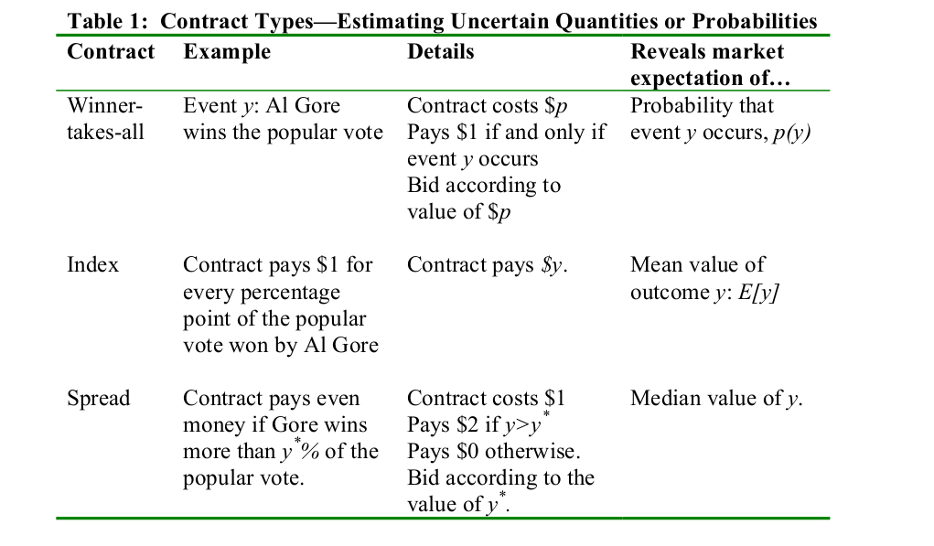

Slide 9
Theory
Prices should be (and often are) efficient: Price should be equal to expected payout (although small markets may absorb information less quickly than larger markets)
Marginal trades should be (and often are) rational: No systematic biases should arise (although people often trade according to desires rather than beliefs)
Markets should (and often do) contain few arbitrage opportunities: The same contracts should trade at the same price on different exchanges

Slide 10
Quick example of arbitrage:
Market A sells "Biden decides to run again in 2024" contract for $0.75
Market B sells "Biden decides to NOT run again in 2024" contract for $0.50
You are poor. You have not a penny to your name | $0 | $0
You short sell 100 contracts on A. (I.e. you borrow contracts and sell them. You will have to return them later.) | +$75 | $75
You buy 100 contracts in market B | -$50 | $25

Slide 11
Biden decides to run in 2024
Market A sells "Biden decides to run again in 2024" contract for $0.75
Market B sells "Biden decides to NOT run again in 2024" contract for $0.50
You are poor. You have not a penny to your name | $0 | $0
You short sell 100 contracts on A. (I.e. you borrow contracts and sell them. You will have to return them later.) | +$75 | $75
You buy 100 contracts in market B | -$50 | $25
Your contracts on market B are worth $100. | +$100 | $125
You return 100 shares that you borrowed on Market A (now worth $100). | -$100 | $25
Profit |  | $25

Slide 12
Biden decides to NOT run in 2024
Market A sells "Biden decides to run again in 2024" contract for $0.75
Market B sells "Biden decides to NOT run again in 2024" contract for $0.50
You are poor. You have not a penny to your name | $0 | $0
You short sell 100 contracts on A. (I.e. you borrow contracts and sell them. You will have to return them later.) | +$75 | $75
You buy 100 contracts in market B | -$50 | $25
Your contracts on market B are worth $0. | +$0 | $25
You return 100 shares that you borrowed on Market A (now worth $0). | $0 | $25
Profit |  | $25

Slide 13
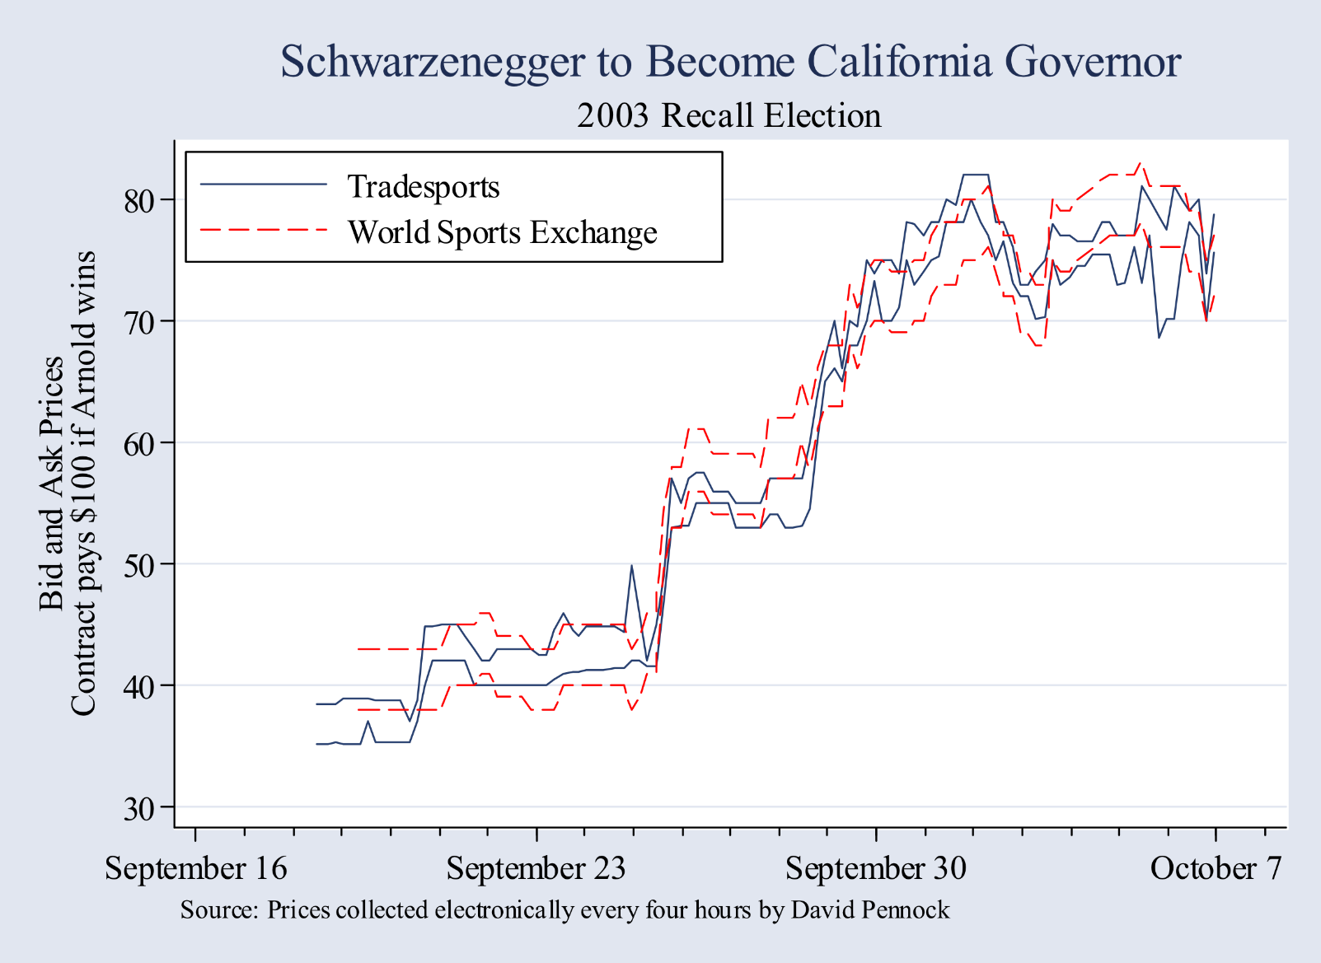
Theory
Theory

Slide 14
Theory
Some more motivating observations:
People shouldn't (but often do) tend to overvalue small probabilities
People shouldn't (but often do) undervalue near certainties
This is known as the “favorite-longshot bias”
Take away: Markets will likely do a worse job at predicting small probability events
"...some prediction markets will work better when they concern events that are widely discussed, since trading on such events will have higher entertainment value and there will be more information on whose interpretation traders can disagree. Ambiguous public information may be better in motivating trade than private information, especially if the private information is concentrated, since a cadre of highly informed traders can easily drive out the partly informed, repressing trade to the point that the market barely exists."
Wolfers and Zitzewitz 2004

Slide 15
Theory
For simplicity, our definition of prediction markets:
Does not include markets in which holding the good is inherently enjoyable (e.g. sports betting)
Does not include markets large enough to allow risk sharing
Includes only risk neutral probabilities
Binary contracts paying $1 dollar if event occurs, $0 otherwise
Wealth is orthogonal to event outcome and to beliefs
Market is large and participants are price takers
Beliefs are heterogeneous and reflect private, noisy signals of whether the event will occur
(as always, these assumptions can be relaxed if you feel like doing uglier math...)
Notes:
The market is large enough to allow risk sharing. One person cannot hold all of the control in one outcome.
only risk neutral probabilities = people don’t care about riskiness itself. If your probability is 5%, and that’s very low, but people are still comfortable holding at that level, and they’re not scared off by long-shots.
One person cannot dominate the market. There will be enough people who hold contract that it can’t be skewed.

Slide 16
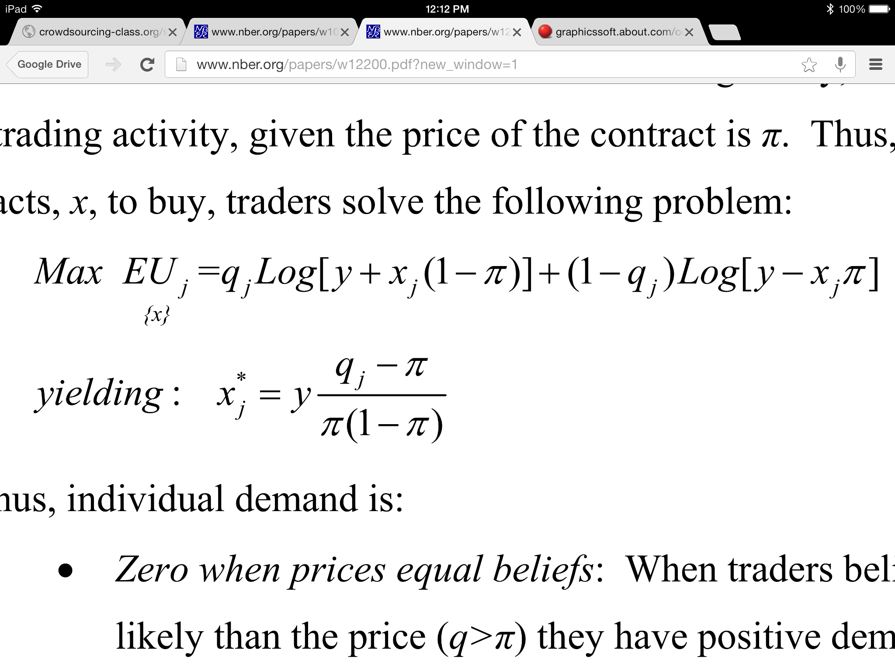
P(winning) *
(wealth if you win)
+ P(losing) *
(wealth if you lose)
y: wealth
xj: number of contracts person j should buy
π: price of the contract
qj: person j's believed P(event)
Notes:
P(winning) * (wealth if you win)
P(losing) * (wealth if you lose)
Then you solve for X. That tells you how many contracts you should buy.

Slide 17
Demand is:
0 when price is equal to beliefs
Linear in beliefs: Given y, demand increases with q
Decreasing in risk: Lower when pi close to ½
Increasing in wealth: Given q, demand increases with y
Unique for prices between 0 and 1

Slide 18
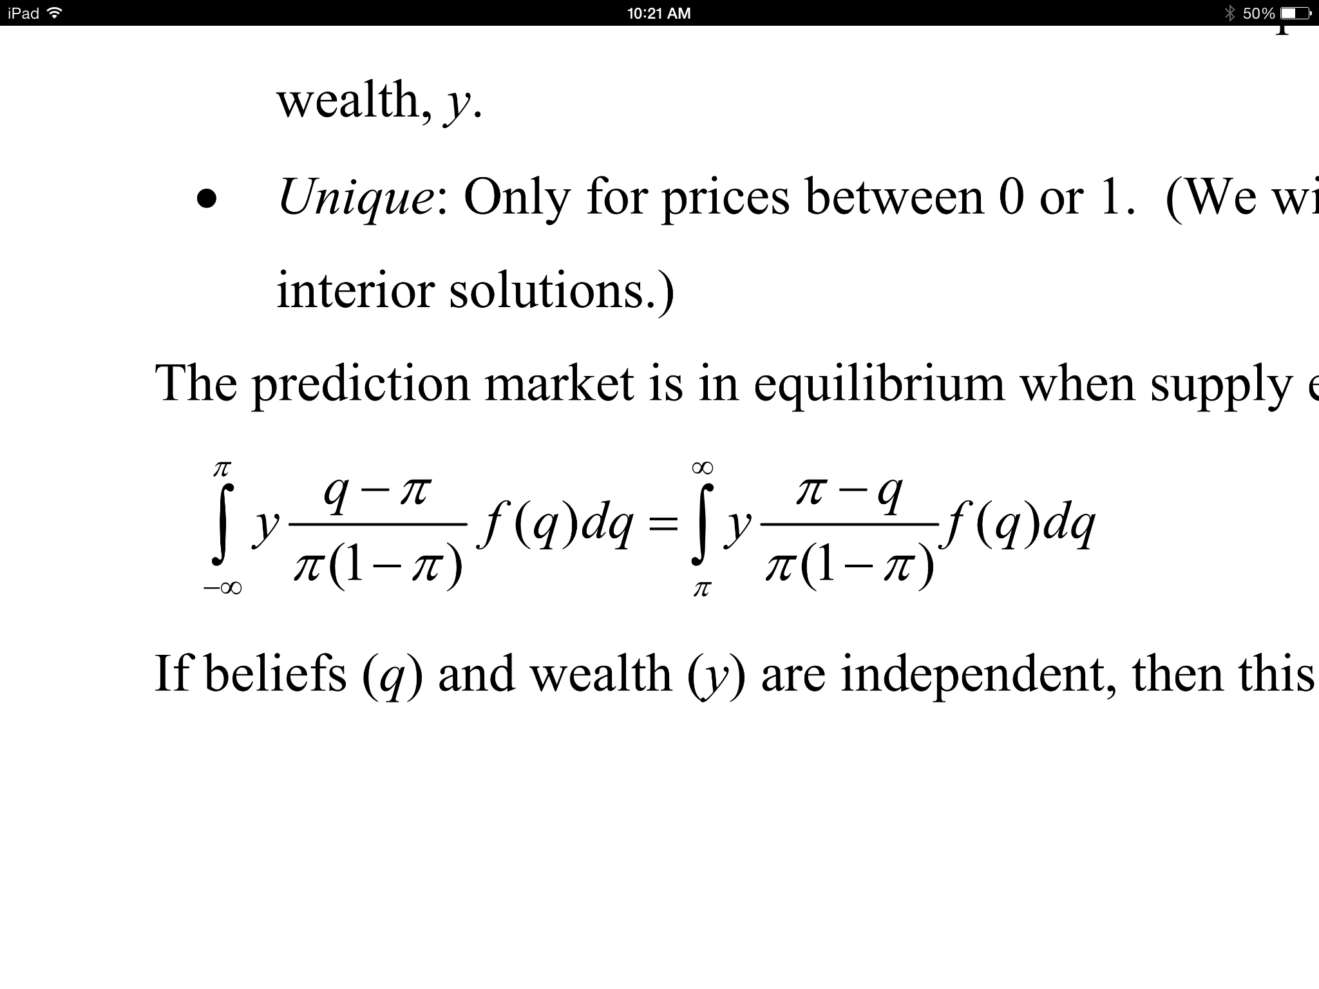
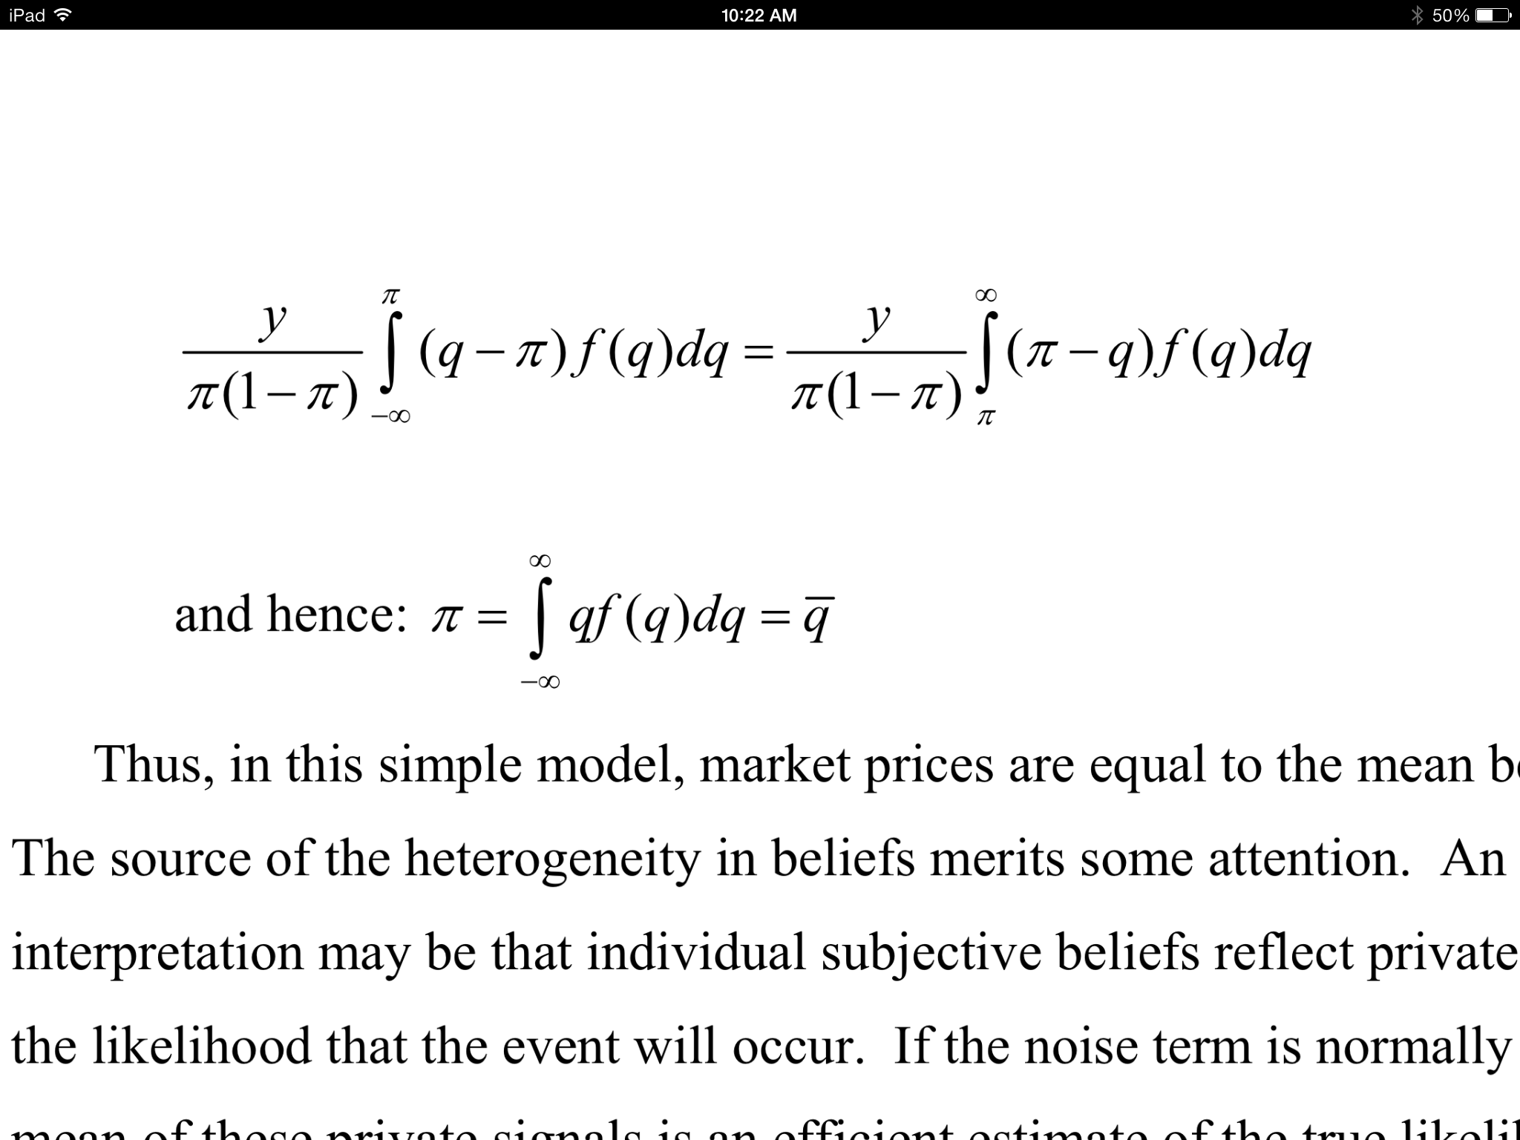
Price equal to mean(q) when supply = demand
Notes:
Here's how you find the equilibrium.

Slide 19
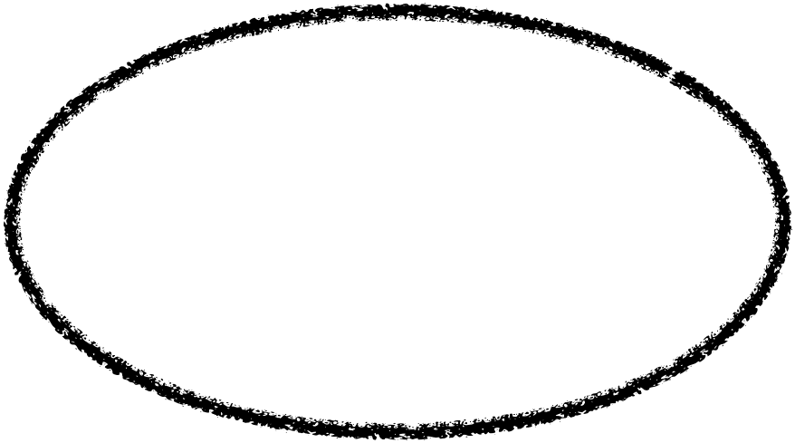
Price equal to mean(q) when supply = demand
At any price below equilibrium, consumers will be better off than producers (they are getting away with paying too little).
Notes:
This is how you find the average of the probability. This side is for buyers.

Slide 20
Price equal to mean(q) when supply = demand
At any price above equilibrium, producers will be better off than consumers (they are getting away with charging too much).
Notes:
This side is for the sellers.

Slide 21
Price equal to mean(q) when supply = demand
All the well-off-ness of consumers
All the well-off-ness of producers
Math
Average of all participants beliefs

Slide 22
Practice
For business/pleasure: Intrade, Tradesports
For research: Iowa Election Markets
For government: PAM (Policy Analysis Market)
For companies internally: HP (printer sales), Siemens (ability to meet deadlines)
Notes:
Intrade and Tradesports were shut down in the USA for violating betting laws.
PAM = Policy Analysis Market. Spun as "The government is allowing people to profit off of terrorist attacks".

Slide 23
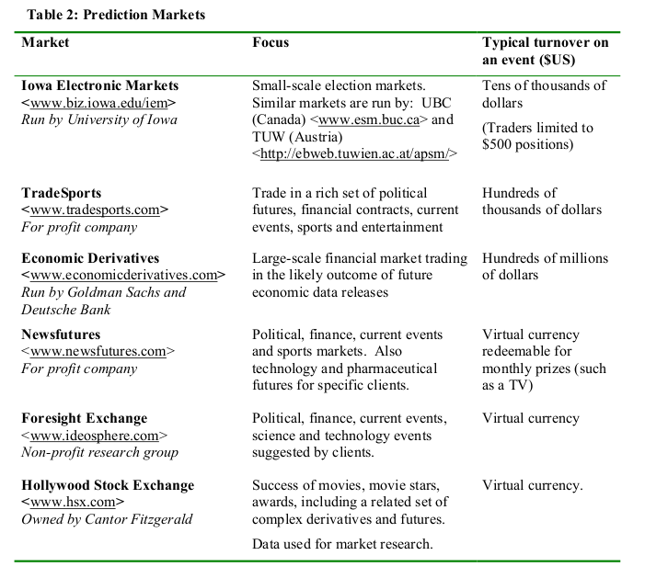
Practice

Slide 24
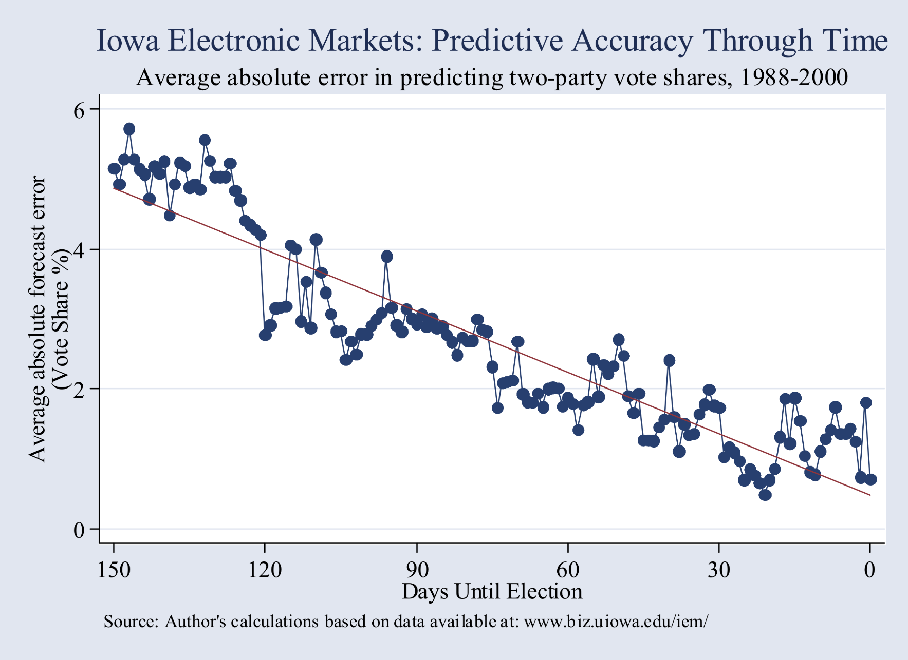

Slide 25
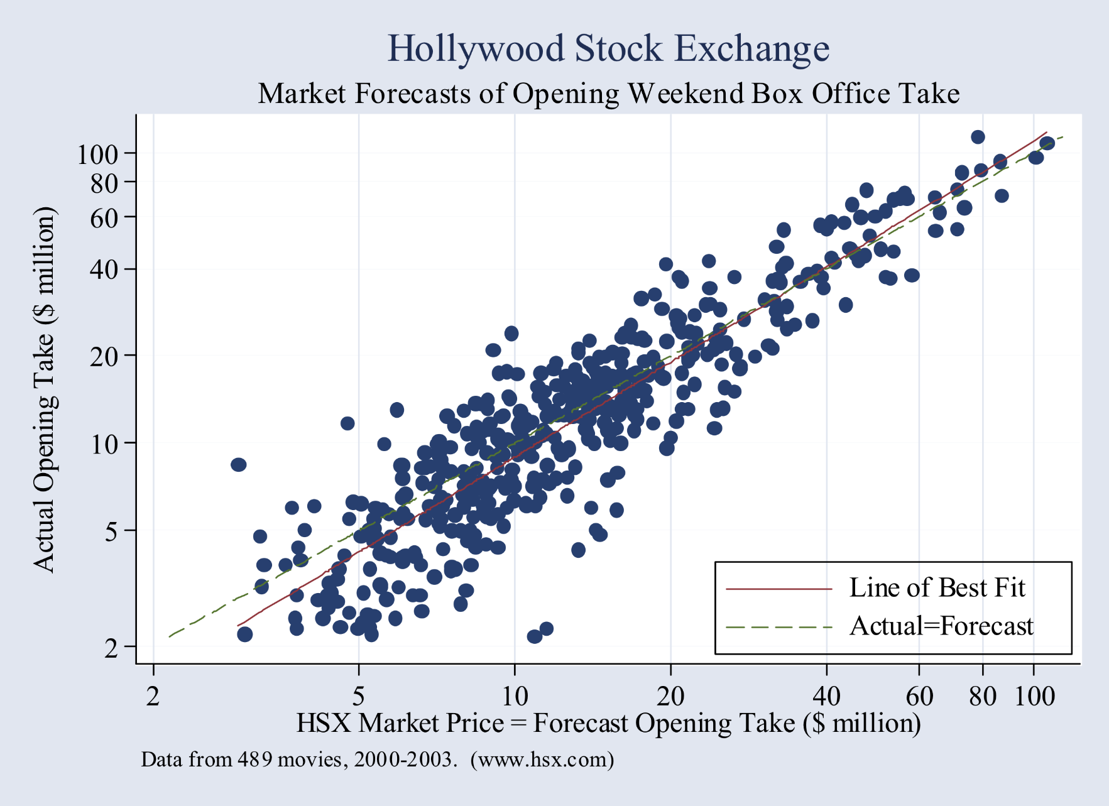

Slide 26
Case Study
Google’s Prediction Market
Source:
http://www.eecs.harvard.edu/cs286r/courses/fall10/papers/GooglePredictionMarketPaper.pdf

Slide 27
Research Questions
"...internal prediction can provide insight into how organizations process information. Prediction markets provide employees with incentives for truthful revelation and can capture changes in opinion at a much higher frequency than surveys, allowing one to track how information moves around an organization and how it responds to external events."
Cowgill, Wolfers, and Zitzewitz 2009

Slide 28
Research Questions
Optimism in entrepreneurial firms: "Entrepreneur’s curse" suggests that entrepreneurial firms tend to be optimistically biased about their potential for success.
Employee communication in organization: Firms pay high costs to cluster in places like Silicon Valley; prediction markets can be used as high‐frequency, market‐incentivized surveys to track information flows in real‐time.
Social networks and information flows among investors: Prediction markets as a way to test the importance of physical proximity and social networks in facilitating information sharing

Slide 29
Market Overview
Launched April 2005, each quarter from 2005Q2 to 2007Q3 had 25‐30 markets
Question that has 2‐5 mutually exclusive and exhaustive answers, e.g.
Q: “How many users will Gmail have?”
A : “Fewer than X users”, “Between X and Y”, “More than Y”.
Answer corresponds to a security that is worth one “Gooble” if the answer turns out to be correct
At the end of the quarter, Goobles were converted into raffle tickets and prizes were raffled off
Prize budget was $10,000 per quarter ($25‐100 per trader)
Out of 6,425 employees who had accounts, 1,463 placed at least one trade.

Slide 30
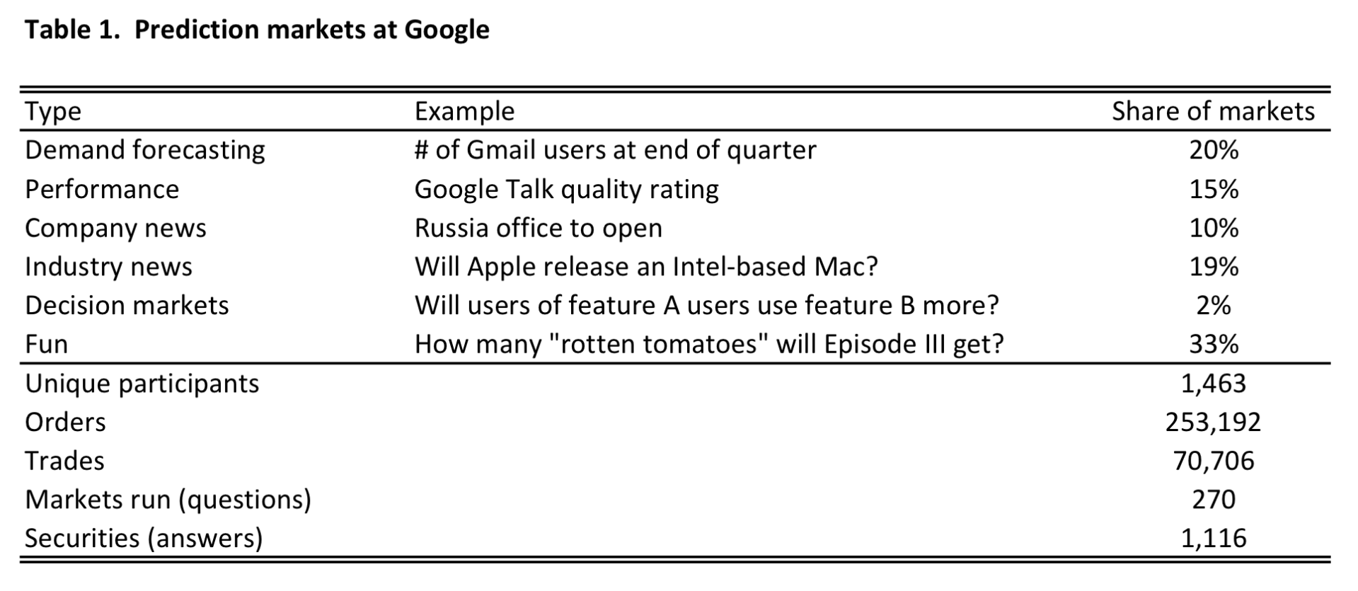
Market Overview

Slide 31
Market Overview
Short selling is not allowed; traders can buy a set of securities and then sell the ones they choose.
There is no automated market maker, but several employees did create robotic traders that sometimes played this role.
Volume in “fun” and “serious” markets are positively correlated

Slide 32
Market Overview
Participants were not representative of Google as a whole
More likely to be in programming roles
More likely to be in Mountain View or New York campuses
More quantitative backgrounds (e.g. undergraduate major)
More interest in investing or poker (e.g. mailing lists)
Employed longer, less likely to leave after study
Slightly more senior (levels from CEO)

Slide 33
Biases
Overpricing of favorites
Underpricing of extreme outcomes
Short aversion
Optimism

Slide 34
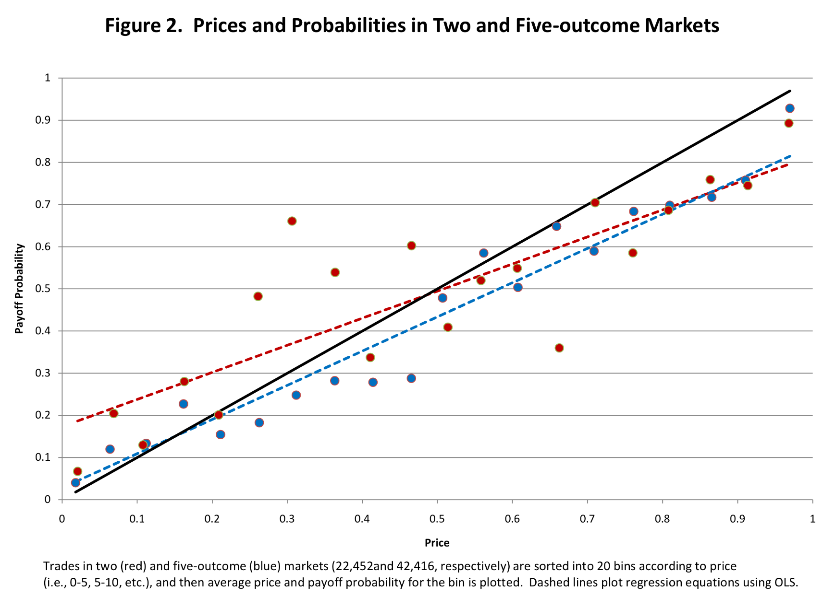
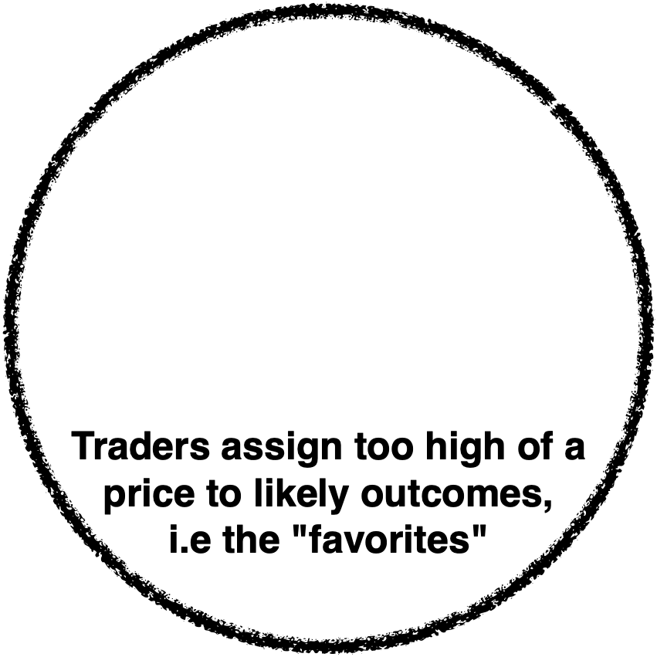
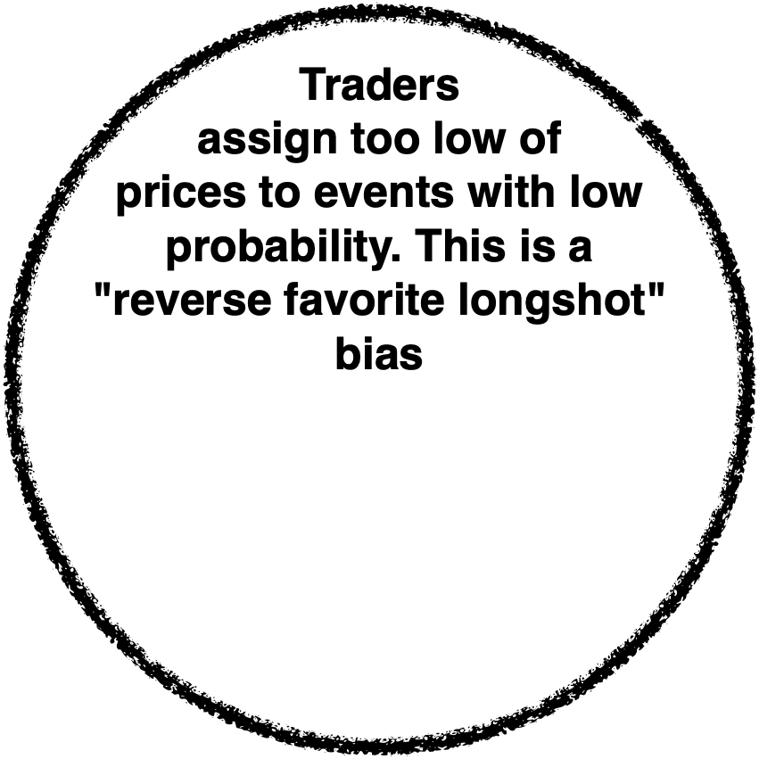
Notes:
Here’s the probability of something paying off versus the price. So for the high red point, people paid 30 cents, when the probability payoff was actually nearly 70%.
Black line is ideal.
Redline down here shows people underestimate unlikely events.
Same on this side. People overestimate high probability events.
Kind of the opposite of what happens in horse racing when people bet on the long shot since they like the idea of a windfall.

Slide 35
Short Aversion
1,747 instances where the bid prices of the securities in a particular market added to more than $1
Arbitrage opportunity from buying a bundle of securities for $1 and then selling the components
Only 495 instances where the ask prices added to less than 1 (arbitrage opportunity of buying the components of a bundle for less than $1).
This is called "short aversion," bias toward holding long positions rather than short ones
Notes:
Buy the whole bundle for $1, sell each component, then I would make more than $1. Short aversion

Slide 36
Biases
Markets overpriced securities tied to optimistic outcomes by 10 percentage points
The optimistic bias was significantly greater on and following days when Google stock appreciated
Partly driven by the trading of newly hired employees; employees with longer tenure were better calibrated
The optimistic bias was largest in:
Two outcome markets
Early in the sample period
Earlier in each quarter
Categories where outcomes are under the control of Google employees i.e. company news (office openings), performance (project completion and product quality)

Slide 37
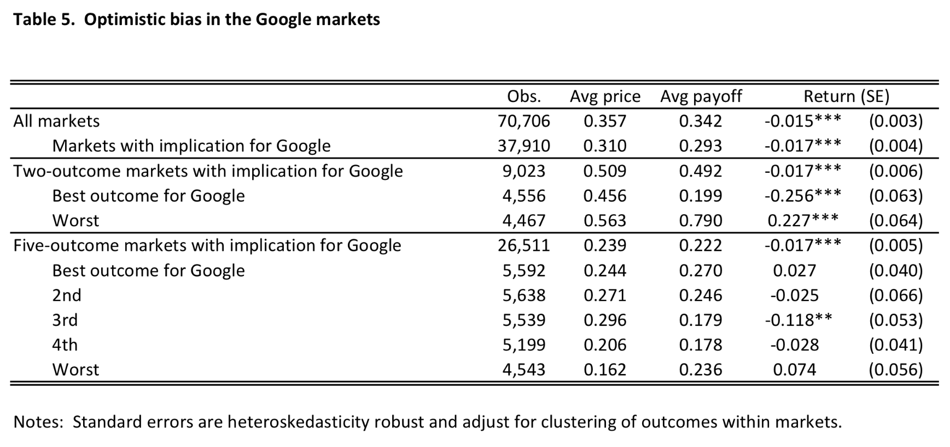

Notes:
What you care about here is the difference between average payout and average price. Negative = people lost money. People tended to lose money by ooverestimating the probability that the positive event would occur. People who were pesimistic tended to make money.

Slide 38
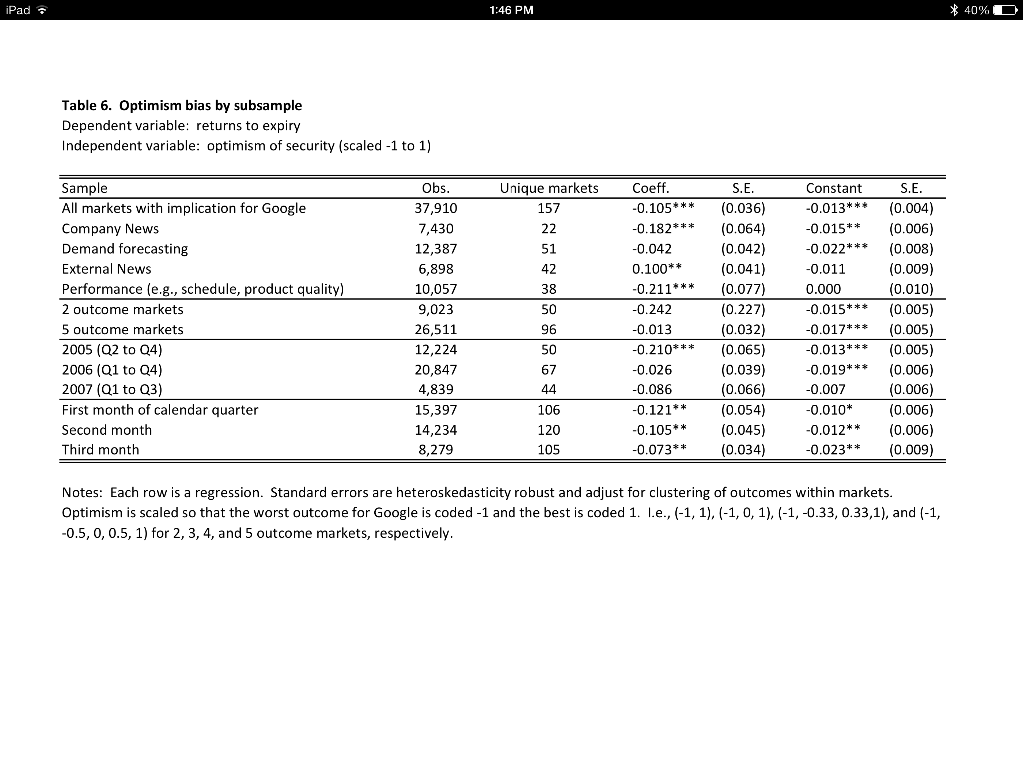

Slide 39
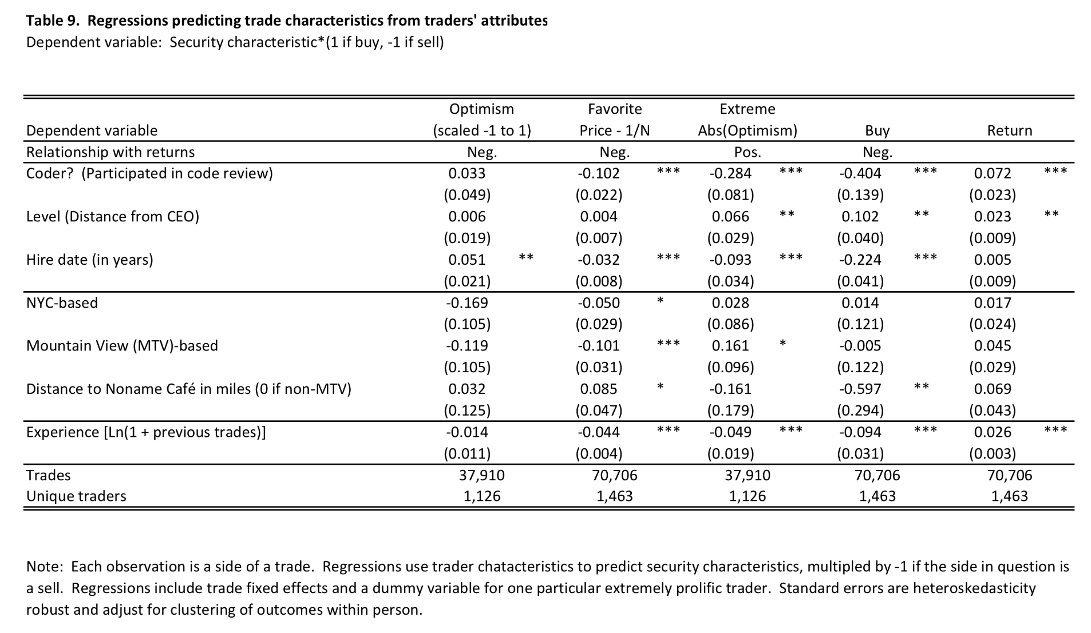

Slide 40
New hires more likely to take optimistic positions and more likely to hold short positions, but less likely to over invest in favorites...

Slide 41
Coders act the same way...

Slide 42
More experienced traders are more likely to trade against the market's biases...

Slide 43
Correlations
Study information flows using measures of "proximity":
Geographical
Organizational
Social
Demographic
Take the participants in each trade to be exogenous (This is reasonable, since it would be largely determined by when they have time available e.g., while code is being compiled and tested)
Predict the size and direction of the trades from the prior positions of proximate colleagues
Notes:
exogenous = relating to or developing from external factors.

Slide 44
Correlations
If trader i buys a security from trader j at some price, we can infer that i’s subjective belief about its payoff probability is higher than j’s
If a third trader k holds a large long position in the security prior to the trade, we can infer that her subjective belief about the value of the security is higher than if she were holding a short position
Test whether the buyer in a particular transaction is more proximate to other traders with prior long positions

Slide 45
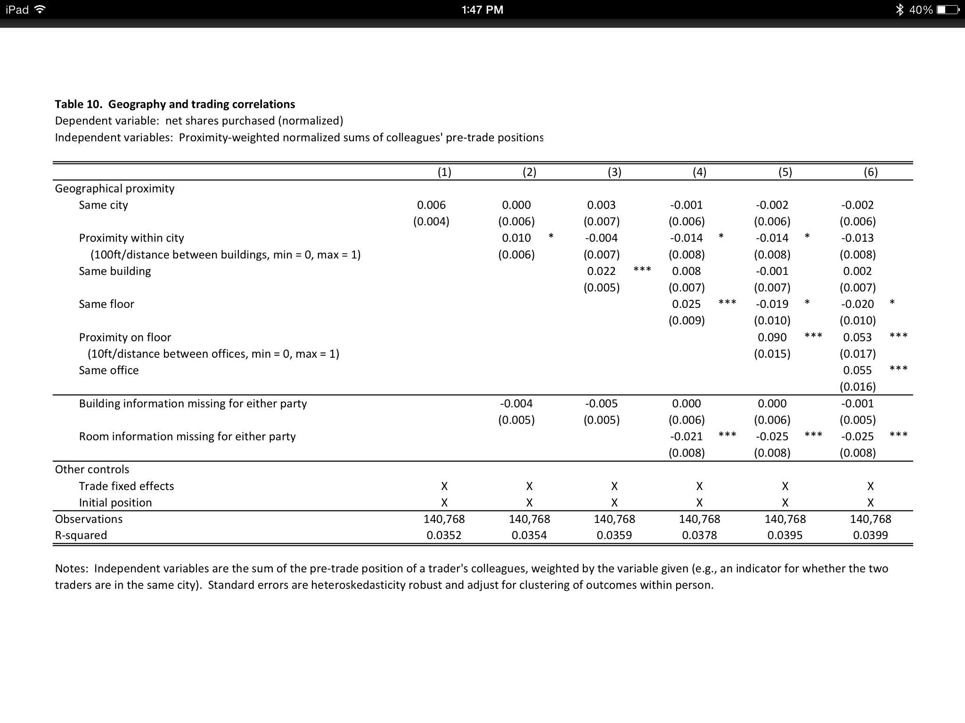
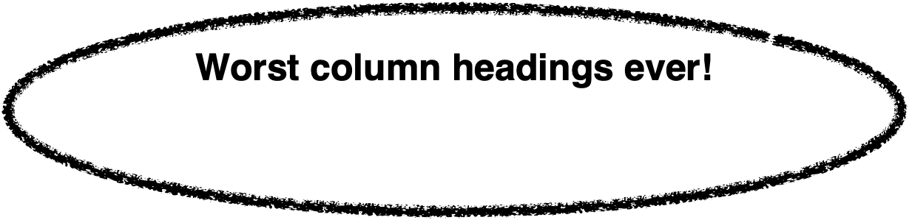

Slide 46

Mystery dimension of increasingly narrowing definition of proximate

Slide 47
Kind of in same general area
One person sitting on the other's lap
Most correlation between employees sharing an office

Slide 48
Kind of in same general area
One person sitting on the other's lap
Correlation decreases with distance, even on the same floor

Slide 49
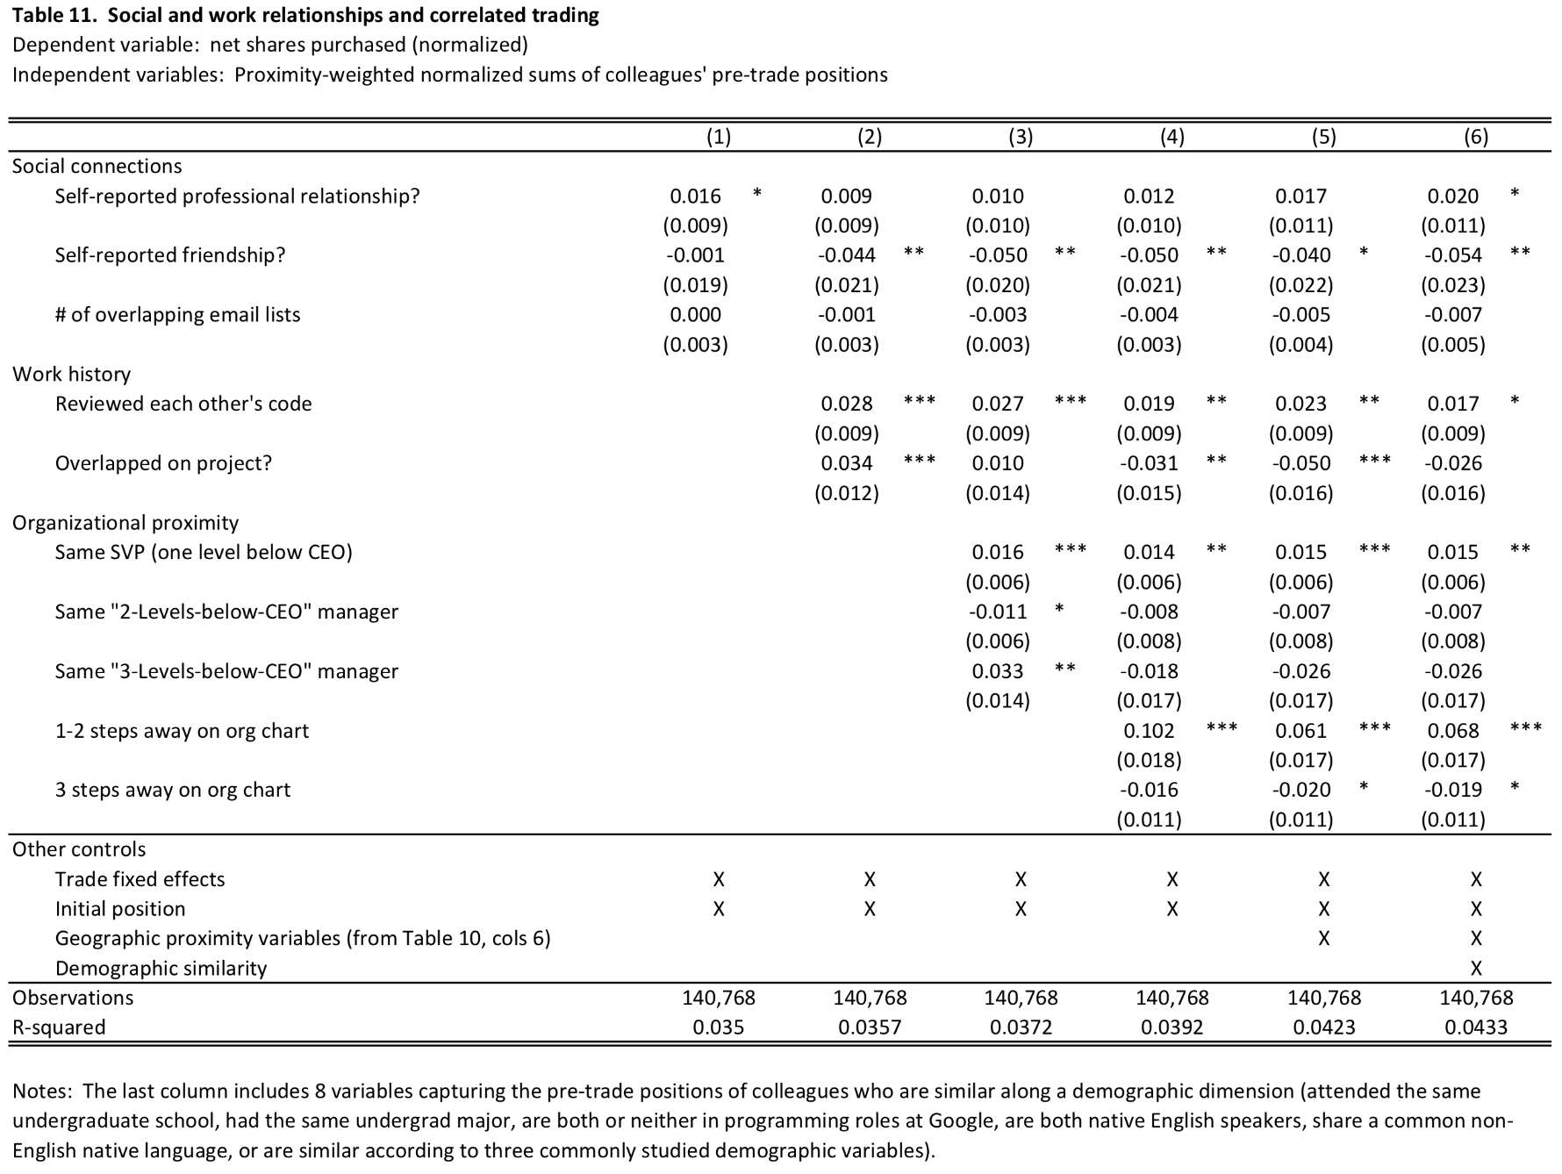
"We find that measures of social connections, either self‐reported on the April 2006 survey or inferred from subscriptions to email lists, do not explain trading correlations well. A history of reviewing each other’s code or overlapping on a project does, however."

Slide 50
"The single best explanator is being within one or two steps on the organization chart (i.e., sharing a manager, being someone’s manager, or being someone’s manager’s manager)."

Slide 51
"...employees most likely to have correlated trading are those who are proximate organizationally or geographically and are not friends. One admittedly speculative interpretation of this result is that friends have better things to discuss than the subjects of prediction markets, while the prediction markets provide a topic of conversation for those who are not friends."

Slide 52
Summary
Prediction markets are simple securities markets that allow traders to profit from correct private information about the outcomes of future events
Individuals' desires to make money allows the market to aggregate all of the traders' beliefs, reflected in the price
These markets have been shown to behave efficiently, and provide correct predictions with high accuracy
Markets can be used by companies and researchers to make business decisions, study organizational structures, and measure social networks
Using prediction markets for this kind of research is more "real-time" and possibly more accurate than using retrospective surveys

Slide 53
Sources
Prediction Markets
by Justin Wolfers and Eric Zitzewitz
http://www.nber.org/papers/w10504.pdf
Using Prediction Markets to Track Information Flows: Evidence from Google
by Bo Cowgill, Justin Wolfers, and Eric Zitzewitz
http://www.eecs.harvard.edu/cs286r/courses/fall10/papers/GooglePredictionMarketPaper.pdf

